Slide 1

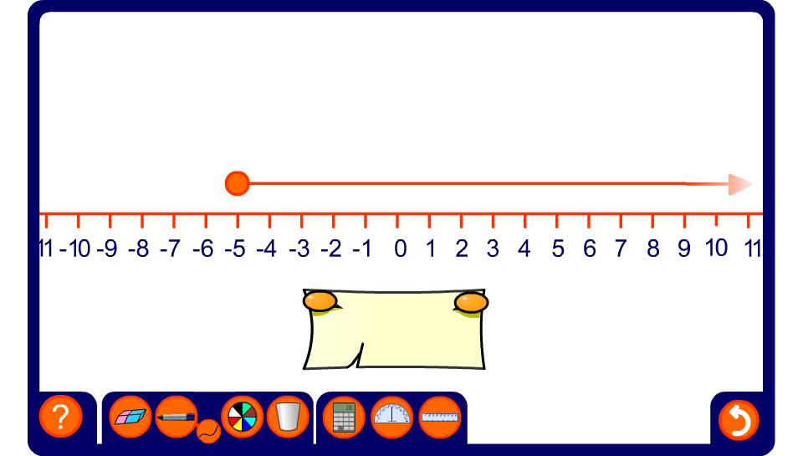


Writing inequalities from number lines

